Slide 1
Intelligent Power-Electronics (Inverter) Control
Kun Zhang
Clayton Campus
7th June, 2013
Notes:
Hi, my name is Kun Zhang. My final year project is intelligent power-electronics control. This project is an industry-based project, which is offered and supervised by Simplex CNC Systems.

Slide 2
Introduction
A current-controlled AC-AC inverter
Motor control and other applications
Real-time controlling of the inverter parameters
Input and Output Filters
Intelligent Power-Electronics (Inverter) Control
7th June 2013
Notes:
The project is to design a current-controlled AC-AC inverter system which can be used for motor control and other applications. The innovation of the inverter involves real-time controlling of the inverter parameters and the control methodology applied. Also, filters are to be designed and utilised extensively to eliminate possible noises and harmonics.

Slide 3
Outline
AC-AC Conversion methods
Electric Protection
Filtration
Simulations
Factory Work
Intelligent Power-Electronics (Inverter) Control
7th June 2013
Notes:
I am going to talk about AC-AC Conversion methods first, and then I am going to introduce electric protection and filtration used in power electronics systems. Simulations have also been done to simulate the system I designed. At last, I am going to talk about the factory works I’ve been doing for the past seven weeks

Slide 4
AC-AC Conversion
Cycloconverter
DC-link converter
Matrix converter
Intelligent Power-Electronics (Inverter) Control
7th June 2013
Notes:
Firstly, we need to choose an AC-AC conversion method for our inverter. Three common methods have been considered; they are cycloconverter, DC-link converter and matrix converter.

Slide 5
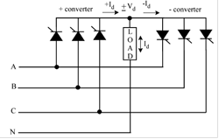
Cycloconverter
Synthesizing the output waveform from segments of the AC supply
From high frequencies to low frequencies
In our application, freq. desired 0~400Hz
Not suitable
Intelligent Power-Electronics (Inverter) Control
7th June 2013
Notes:
Cycloconverters synthesize the output waveform from segments of the AC supply. By controlling the switching patterns of the power switches, cycloconverters are able to convert an AC waveform to another AC waveform of a lower frequency. This puts a limit on the usage of cycloconverters as in our application, the frequency desired is 0~500 Hz with the input frequency of 50Hz. So, cycloconverters are not suitable for our design.

Slide 6
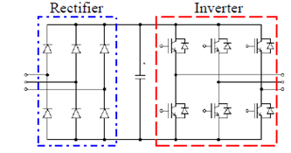
DC-link converter
AC-DC-AC
Rectifier-DC link- Inverter
DC-link, large capacitor, prevent transient from flowing back
Drawback: large capacitor
Intelligent Power-Electronics (Inverter) Control
7th June 2013
Notes:
Next, lets consider DC-link converters. A DC-link converter converters AC from the mains to DC, and then inverters the DC to an AC with different frequencies. It consists of a rectifier at the supply side and an inverter (usually a voltage-controlled inverter) at the load side. The DC link shown in the middle is a large capacitor. It transmits the DC voltage to the inverter, preventing transients from flowing back to the input and provides some isolation from the utility line. The drawback of DC-link converters is they use large storage capacitors which have short lifetime and are bulky in size

Slide 7
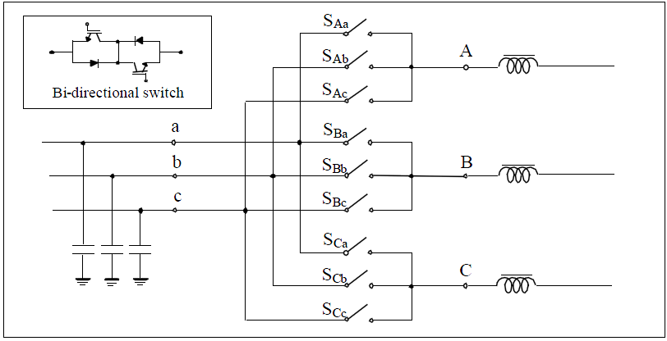
Matrix Converters
9 bi-directional switches (18 transistors)
Only one bi-directional switch per phase , or short-circuited
Minimal harmonics
Complex implementation, higher price
Intelligent Power-Electronics (Inverter) Control
7th June 2013
Notes:
A matrix converter has 9 bi-directional switches (18 transistors) that allow any output phase to be connected to any input phase. The input phases should never be short-circuited and the output currents should not be interrupted. This implies that one and only one bi-directional switch per output phase must be switched on at any instant. The primary advantage is that it reduces the harmonics significantly, hence less complicated filters are needed. However, the implementation and algorithms to control the switches are complex, and the cost is high.

Slide 8
Conversion methods comparison
Cycloconverter, not suitable
DC-link converter: contains harmonics
Matrix converter, complex, high price
DC-link is the optimal choice
Intelligent Power-Electronics (Inverter) Control
7th June 2013
Notes:
Now, we can compare the three methods. As mentioned earlier, cycloconverters do not meet our frequency requirement, thus they’re not suitable for our design
Matrix converter is excellent insofar as it produces fewer harmonics and requires minimal capacitors and inductors. Yet, in terms of this project, it is not practical because it is too complex and too expensive.
DC-link converter is less efficient and contains considerable harmonics. However, DC-link converters are more feasible due to its low cost and high stability. Additionally, filters can be designed to reduce the harmonics. As a result, DC-link converter is the optimal choice for our application

Slide 9
Power Modules
Parameter | Ratings
Input Voltage | 220
I_{C} (A) | 8 ~ 35 (at all temperatures)
Switching Frequency (kHz) | 20 ~ 30
Switching Time (us) | 33 ~50
Application Power rating (kW) | 1 ~ 30
Configurations | Full bridge
Switching Devices | IGBTs, GTO, FETs
Output frequency (Hz) | 1 ~ 500
Intelligent Power-Electronics (Inverter) Control
7th June 2013
Notes:
To implement the conversion methods, we need to find a fitting power module first. A power module is a package of six power switching devices which are connected in bridge configurations. The requirements are shown in the table. The important thing is the switching frequency is 20~30 kilo Hz. This means BJTs cannot be used as they are too slow. GTO and power FETs are fast enough but they cannot stand 35A as required. So our choice is IGBT power modules.

Slide 10
Electric Protection
Residual Current Devices
Circuit Breakers
Intelligent Power-Electronics (Inverter) Control
7th June 2013
Notes:
Electric protection is vital in electrical designs as it protects the system and its operators from faults.

Slide 11
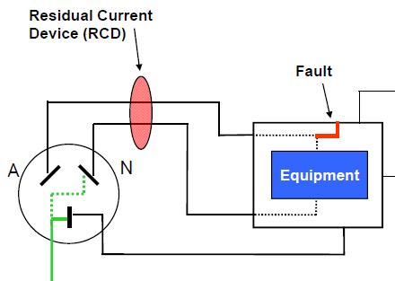
Residual Current Devices
Check balance between in and neutral
Unbalance, break
Type A, AC and pulsating DC
Type B AC, DC
Intelligent Power-Electronics (Inverter) Control
7th June 2013
Notes:
A residual current device disconnects a circuit whenever it detects that the electric current is not balanced between the conductor and the return neutral conductor.
Type A RCDs which can detect full wave AC and pulsating DC residual currents.
Type B RCDs which can detect full wave AC, pulsating DC and pure DC residual
We prefer B as there will be DC current component involved in our application

Slide 12
Circuit Breakers
Residual-current Circuit Breaker (RCCB)
Common RCD
Residual current breaker with over-current protection (RCBO) — protects the system from over-current.
Two RCBO, in case one fails
Intelligent Power-Electronics (Inverter) Control
7th June 2013
Notes:
A circuit breaker is a mechanical switching device, capable of making, carrying and breaking currents under normal circuit conditions.
Residual-current Circuit Breaker (RCCB) is the most common residual current device — detects current imbalance.
On top of that, a Residual current breaker with over-current protection (RCBO) protects the system from over-current. Overcurrent happens occasionally in motor applications, so RCBO is the best protection device in our design. Also, two RCBOs are connected in series, in case one fails

Slide 13
Filtration
AC choke/Line Reactors
EMC filters
Output sine-wave filter
Expected THD<5%
Intelligent Power-Electronics (Inverter) Control
7th June 2013
Notes:
As DC-link converters contain considerable amount of noises, four filters are to be implemented in our design. An ac choke and input EMC filters for the input end and an output EMC filter with an output sine-wave filter for the output end. The total harmonic distortion is expected to be less than 5% for each end.

Slide 14
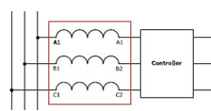
AC choke/Line Reactor
Reduce harmonics
Reduce commutation, inrush currents
Intelligent Power-Electronics (Inverter) Control
7th June 2013
Notes:
An ac choke is in essence an inductor which reduces harmonics from the mains. It also reduces commutation notches and limits inrush currents.

Slide 15
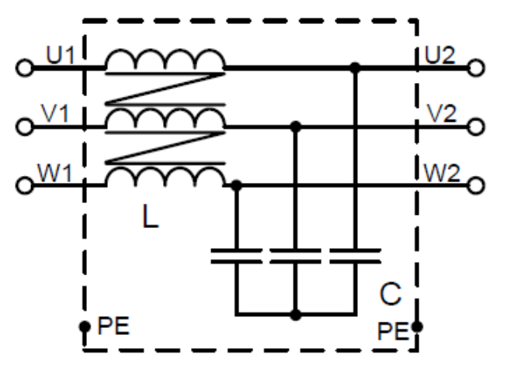
EMC filters
Reduce the values of dv/dt
Both input and output
Reduce motor insulation stress
Intelligent Power-Electronics (Inverter) Control
7th June 2013
Notes:
(Electromagnetic compatibility) EMC filters reduces the values of dv/dt, thus avoiding sharp changes. The dv/dt filters have cut-off frequency above the switching frequency. These filters also reduce the motor insulation stress. They are designed to be implemented at both input and output end.

Slide 16
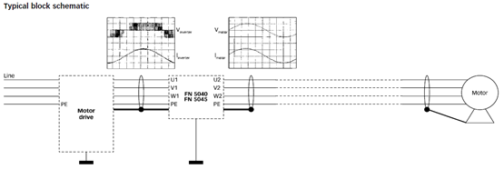
Output sine-wave filters
Reduce harmonics in the output
Reduce bearing current
Reduce insulation stress
Intelligent Power-Electronics (Inverter) Control
7th June 2013
Notes:
Sine-wave filters provide a sinusoidal phase-to-phase motor voltage filtration. They have three effects: they reduce harmonics in the output; they reduce bearing current especially in large motors; Also, they reduce insulation stresses

Slide 17
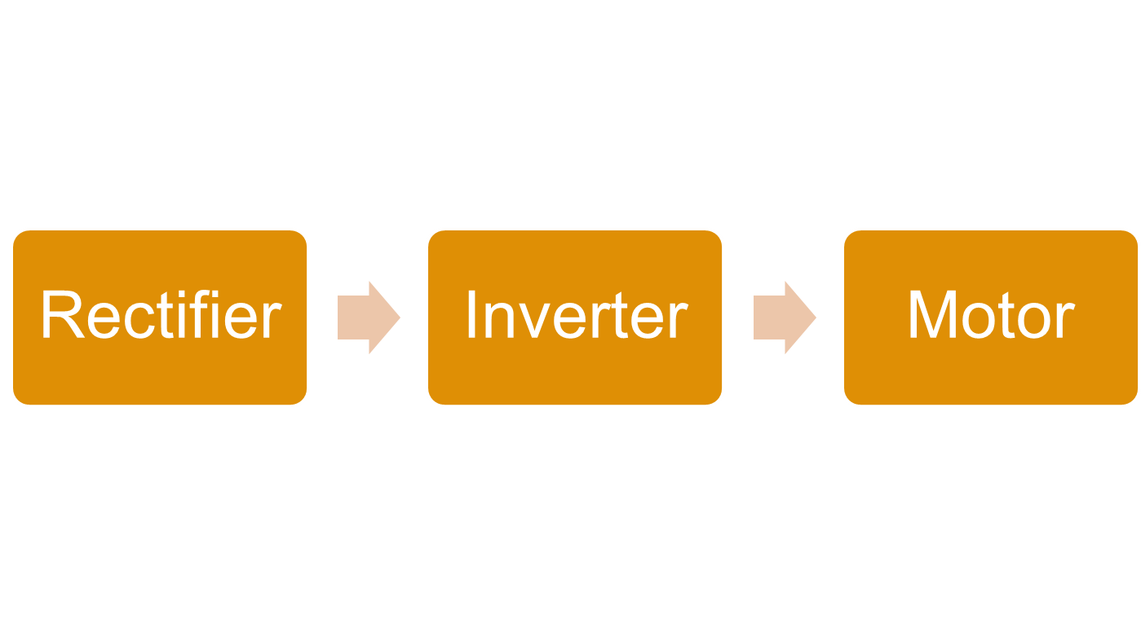
Simulation - System overview
Intelligent Power-Electronics (Inverter) Control
7th June 2013
Notes:
The system I designed was simulated using Simulinks in MATLAB.
In brief, the DC-link inverter system consists of three blocks, a rectifier rectifies the mains, an inverter converts the DC to desired AC ---- which is fed to a motor. The simulation at this stage is done in open-loop. However, the system will be closed-loop controlled

Slide 18
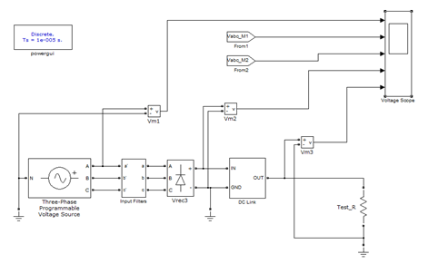
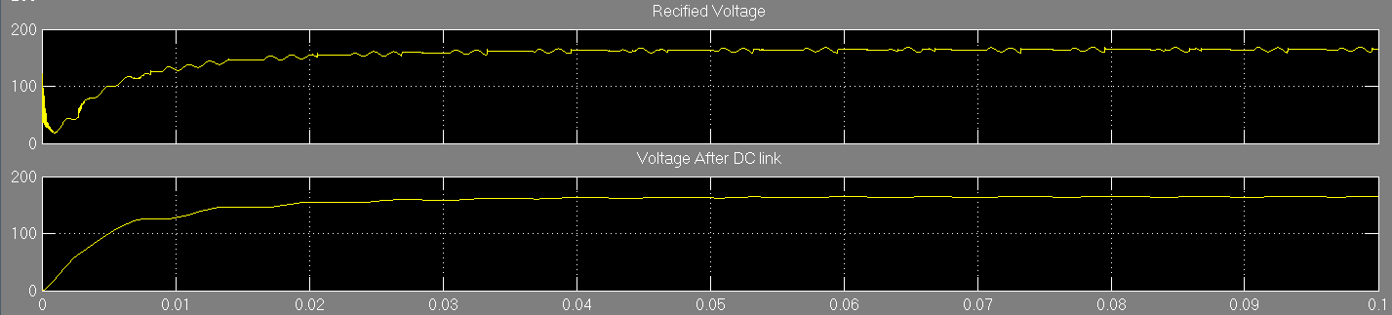
Rectifier Simulation
Intelligent Power-Electronics (Inverter) Control
7th June 2013
Notes:
The rectifier is constructed by six diodes with RC snubbers.
The AC source is configured in a way that it contains some harmonics, which is supposed to be filtered by the input EMC filter and input ac choke.
The rectification schematic also includes the DC-link section which contains an inductor with a large storage capacitor.
The first graph is the rectified voltage after the rectifier and the second graph is the voltage after DC link. It can be seen here that the stabilized output of the rectifier contains mainly DC with moderate distortions. These distortions are further reduced by DC-link.
The voltage is almost DC with a voltage of 150V

Slide 19
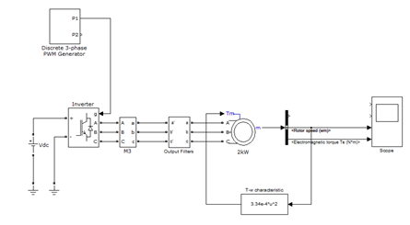
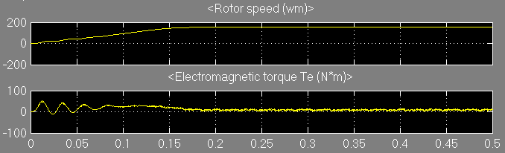
Inverter + Motor Simulation
Intelligent Power-Electronics (Inverter) Control
7th June 2013
Notes:
The motor simulation assumes the input of the inverter to be a well-rectified DC, which is modelled by a DC source. The three-phase PWM generator is set to generate a 100Hz modulation signal feeding into the inverter. The torque is fed back to the induction motor with a torque-speed characteristic as shown.
The first graph shows the rotor speed and the second graph shows the electromagnetic torque. It can be observed that the rotor speed is constant after 0.18s while the torque stabilizes after the same period of time. The rotor speed is around 180 rad/s (57Hz) because the slip of the induction motor was set to 0.5.

Slide 20
Factory Work
Assemble cabinets
Wiring
Device installation
Assemble PC
Intelligent Power-Electronics (Inverter) Control
7th June 2013
Notes:
This is an industry-based project, so a considerable amount of works were done in factory. The factory works include assembling cabinets, wiring, device installation and assembling PCs. The cabinets are designed to hold the inverters and the filters. Rivets had to be punched into the metal plates first so that the they could assembled by screws. Once the cabinets were assembled, some model devices were installed in them. This was done by drilling holes to the metal plates of the cabinets and attached the model devices to the plate using's screws via those holes. Then, proper wiring paths were designed and the devices were wired accordingly. In addition, I also learnt and assembled a PC in the factory.

Slide 21
Thank you for listening!
Intelligent Power-Electronics (Inverter) Control
7th June 2013
Notes:
Thank you for listening

